Slide 1
Exception handling

Slide 2
What is exception?
Exception is an unwanted or unexpected event, which occurs during the execution of a program, i.e. at run time, that disrupts the normal flow of the program’s instructions.
These exceptions can occur for various reasons, such as invalid user input, file not found, or division by zero, etc.
Exception handling in Java is a powerful mechanism to handle runtime errors, ensuring the normal flow of the application even when unexpected conditions occur.
When an exception occurs within a method, it creates an object known as the exception object. It contains information about the exception, such as the name and description of the exception and the state of the program when the exception occurred.

Slide 3
Exception example
public class ExceptionObjectExample {
public static void main(String[] args) {
divide(10, 0); // Attempt to divide by zero
System.out.println("This line will not be executed."); // This will not run if an exception occurs
}
public static int divide(int numerator, int denominator) {
return numerator / denominator; // This line throws an ArithmeticException if denominator is 0
}
}
Output: Exception in thread "main" java.lang.ArithmeticException: / by zero
at ExceptionObjectExample.divide(ExceptionObjectExample.java:10)
at ExceptionObjectExample.main(ExceptionObjectExample.java:5)

Slide 4
Exception handling using try-catch
public class ExceptionObjectExample {
public static void main(String[] args) {
try {
divide(10, 0); // Attempt to divide by zero
}
catch (ArithmeticException e) {
System.out.println("Exception caught: " + e);
}
}
public static int divide(int numerator, int denominator) {
return numerator / denominator; // This line throws an ArithmeticException if denominator is 0
}
}
Output:
Exception caught: java.lang.ArithmeticException: / by zero

Slide 5
Major reasons why an exception Occurs
Invalid user input
Device failure
Loss of network connection
Physical limitations (out-of-disk memory)
Code errors
Out of bound
Null reference
Type mismatch
Opening an unavailable file
Database errors
Arithmetic errors

Slide 6
Exception-Handling Fundamentals
Keyword | Description
try | Program statements that you want to monitor for exceptions are contained within a try block. If an exception occurs within the try block, it is thrown. we can't use try block alone. The try block must be followed by either catch or finally.
catch | The catch block is used to handle the exception. It must be preceded by try block which means we can't use catch block alone. It can be followed by finally block later.
throw | System generated exceptions are automatically thrown by the Java run-time system. To manually throw an exception, use the keyword throw.
throws | Any exception that is thrown out of a method must be specified as such by a throws clause.
finally | Any code that absolutely must be executed after a try block completes is put in a finally block.

Slide 7
Exception-Handling Fundamentals
try {
// Code that may throw an exception
} catch (ExceptionType1 e1) {
// Handle exception of type ExceptionType1
} catch (ExceptionType2 e2) {
// Handle exception of type ExceptionType2
} finally {
// Code that will always execute (optional)
}

Slide 8
Exception Hierarchy
All exception types are subclasses of the built-in class Throwable.
Exception class is used for exceptional conditions that user programs should catch. This is also the class that you will subclass to create your own custom exception types. Exceptions of this type are automatically defined for the programs that you write and include things such as division by zero and invalid array indexing.
Error class Represents serious problems that a typical application should not attempt to handle (e.g., OutOfMemoryError, StackOverflowError). These are usually JVM issues.

Slide 9
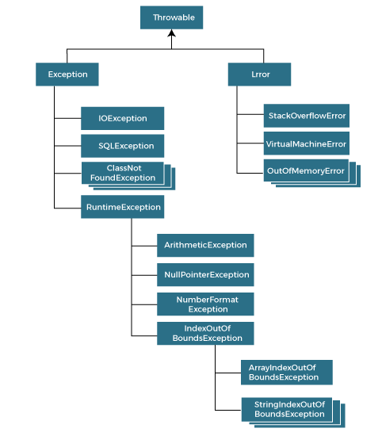

Slide 10
Types of exception
Checked Exception
Unchecked Exception
Errors
Checked Exception: These are the exceptions that are checked at compile time. If some code within a method throws a checked exception, then the method must either handle the exception or it must specify the exception using the throws keyword.
Examples of Checked Exceptions:
  IOException: Occurs during input/output operations, such as reading or writing files.
  SQLException: Happens during database access or interaction with SQL.
  FileNotFoundException: Thrown when a program attempts to access a file that does not exist.
  ClassNotFoundException: Occurs when a specified class cannot be found, often when dynamically loading classes.
Any checked exception is a subclass of Exception.

Slide 11
Example (checked exception)
import java.io.File;
import java.io.FileReader;
import java.io.IOException;
public class CheckedExceptionExample {
public static void main(String[] args) {
try {
File file = new File("nonexistent.txt");
FileReader reader = new FileReader(file); // This may throw a FileNotFoundException
} catch (IOException e) {
System.out.println("An IOException occurred: " + e.getMessage());
}
}
}

Slide 12
Unchecked exception
Unchecked exceptions, also known as runtime exceptions, are not checked at compile-time but at runtime.
These exceptions are typically due to logical errors or programming mistakes and do not need to be declared or caught in the code.
They are subclasses of RuntimeException.
Examples of Unchecked Exceptions:
ArithmeticException: Occurs when an invalid arithmetic operation is performed, such as dividing by zero.
NullPointerException: Thrown when an application tries to access an object with a null reference.
ArrayIndexOutOfBoundsException: Happens when accessing an array with an illegal index (index out of range).
IllegalArgumentException: Thrown when a method receives an invalid argument.

Slide 13
Example (unchecked exception)
public class UncheckedExceptionExample {
public static void main(String[] args) {
int[] numbers = {1, 2, 3};
System.out.println(numbers[5]); // This will throw an arrayIndexOutOfBoundsException
}
}
// In this case, the code compiles fine, but at runtime, ArrayIndexOutOfBoundsException is thrown due to the illegal array index.

Slide 14
Error
Errors are a special type of Throwable that are not exceptions and generally represent issues that are outside the control of the program or JVM.
Errors are typically more serious problems, often involving the Java Virtual Machine (JVM) itself, and are generally not meant to be caught or handled by applications.
Errors are subclasses of java.lang.Error.
Examples of Errors:
  OutOfMemoryError: Thrown when the JVM runs out of memory.
  StackOverflowError: Happens when the call stack overflows, often due to deep or infinite recursion.
  VirtualMachineError: Indicates that the JVM is broken or has encountered a system-level issue.

Slide 15
Example (Error)
public class StackOverflowErrorExample {
public static void main(String[] args) {
recursiveMethod(); // This will throw a StackOverflowError
}
public static void recursiveMethod() {
recursiveMethod(); // Infinite recursion
}
}

Slide 16
Null pointer exception
public class NullPointerExceptionExample {
public static void main(String[] args) {
String str = null; // Initializing a String variable to null
try {
int length = str.length(); // Attempting to call a method on a null reference
System.out.println("Length of the string: " + length);
} catch (NullPointerException e) {
System.out.println("Error: Null reference encountered.");
// Additional error handling code can be added here
}
}
}

Slide 17
Multiple catch Blocks
You can catch different types of exceptions in multiple catch blocks.
Specific exceptions should be caught before more general ones.
public class MultipleCatchExample { public static void main(String[] args) { try { int[] numbers = {1, 2, 3}; int result = numbers[3] / 0; // This line will throw an ArrayIndexOutOfBoundsException first } catch (ArithmeticException e) { System.out.println("ArithmeticException caught: Cannot divide by zero."); } catch (ArrayIndexOutOfBoundsException e) { System.out.println("ArrayIndexOutOfBoundsException caught: Array index is out of bounds."); } catch (Exception e) { System.out.println("General Exception caught: " + e.getMessage()); } System.out.println("Program continues after exception handling."); } } Important: Only one catch block is executed: When an exception is caught, the subsequent catch blocks are skipped. Order matters: Place more specific exceptions before more general ones to avoid compilation errors.

Slide 18
Example of unreachable cache block
public class ExceptionOrderExample {
public static void main(String[] args) {
try {
int result = 10 / 0; // This will throw ArithmeticException
} catch (Exception e) { // General exception
System.out.println("Caught general exception: " + e.getMessage());
} catch (ArithmeticException e) { // More specific exception
System.out.println("Caught ArithmeticException: " + e.getMessage());
}
}
}
Output:
error: exception ArithmeticException has already been caught

Slide 19
Displaying a Description of an Exception
The toString() method prints exception information in the format of the Name of the exception: description of the exception.
import java.io.*;
class Test
{
public static void main (String[] args) {
int a=5;
int b=0;
try{
System.out.println(a/b);
}
catch(ArithmeticException e){
System.out.println(e.toString());
}
}
}
getMessage() : The getMessage() method prints only the description of the exception.
System.out.println(e.getMessage());

Slide 20
How Does JVM Handle an Exception?
1. Exception Occurrence: When an exception occurs, the JVM creates exception object based on the type of exception (e.g., ArithmeticException, IOException).
  int result = 10 / 0; // ArithmeticException occurs due to division by zero
There might be a list of the methods that had been called to get to the method where an exception occurred. This ordered list of methods is called Call Stack.
2. Stack Unwinding: Stack unwinding refers to the JVM's process of unwinding the call stack to find an appropriate exception handler (i.e., a catch block that can handle the exception).
  The JVM starts looking for a matching catch block in the current method, which is the method where the exception occurred.
  If no matching catch block is found, it propagates the exception to the calling method. This continues up the call stack until the exception is either caught or the stack is exhausted.

Slide 21
Example (Stack Unwinding) :
public class Example {
public static void main(String[] args) {
methodA(); // Calling methodA
}
public static void methodA() {
methodB(); // Calling methodB
}
public static void methodB() {
int result = 10 / 0; // ArithmeticException occurs here
}
}
How the JVM handles this:
The exception occurs in methodB().
The JVM searches for a catch block in methodB(). Since there is no catch block in methodB(), the exception propagates to methodA().
Since methodA() doesn’t have a catch block either, the exception propagates to the main() method.
If there’s no catch block in main(), the JVM terminates the program, and the exception is printed on the console.

Slide 22
3. Finding a Matching Catch Block
The JVM continues to propagate the exception up the call stack, looking for a catch block that can handle the specific type of exception or one of its superclasses.
Example:
public class Example {
public static void main(String[] args) {
try {
int result = 10 / 0; // ArithmeticException occurs here
} catch (ArithmeticException e) {
System.out.println("Caught ArithmeticException: " + e.getMessage());
}
}
The exception is caught in the catch (ArithmeticException e) block because it matches the type of the thrown exception (ArithmeticException).
Once the exception is caught, the catch block is executed, and the program resumes normal execution after the try-catch structure.

Slide 23
4. The Finally Block (If Present):
After the exception is handled by the catch block, if there is a finally block present, it is executed regardless of whether an exception was thrown or not.
The finally block is used for cleanup actions like closing file streams, database connections, or releasing resources that were acquired in the try block.
Example:
public class Example {
public static void main(String[] args) {
try {
int result = 10 / 0; // ArithmeticException occurs here
} catch (ArithmeticException e) {
System.out.println("Caught ArithmeticException: " + e.getMessage());
} finally {
System.out.println("This will always execute.");
}
}
}

Slide 24
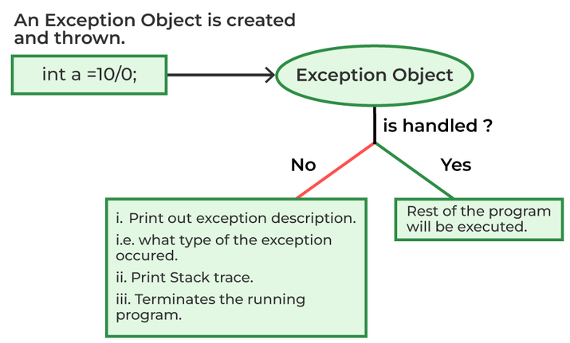
5. Propagating Uncaught Exceptions
If the exception is not caught in any of the catch blocks, it keeps propagating up the call stack.
If it reaches the main method without being handled, the JVM will:
  Print the exception’s stack trace to the console (which helps in debugging).
  Terminate the program (the program ends after the exception).

Slide 25
Nested try block
public class NestedTryExample {
public static void main(String[] args) {
// Outer try block
try {
int result = 10 / 0;
System.out.println("Result: " + result);
// Inner try block
try {
int[] numbers = {1, 2, 3};
System.out.println(numbers[5]);
}
catch (ArrayIndexOutOfBoundsException e) {
System.out.println("Caught ArrayIndexOutOfBoundsException in inner try: " + e.getMessage());
}
} catch (ArithmeticException e) {
System.out.println("Caught ArithmeticException in outer try: " + e.getMessage());
} finally {
System.out.println("Finally block executed after outer try-catch");
}
}
}

Slide 26
throw
It is used to explicitly throw an exception in a program.
Unlike try-catch, which is used to handle exceptions, throw is used to generate an exception.
  throw ThrowableInstance;
  ThrowableInstance must be an object of type Throwable or a subclass of Throwable.
The throw keyword is often used to enforce specific conditions within methods or custom validation.

Slide 27
Example (throw)
public class NullPointerExample {
public static void main(String[] args) {
try {
printLength(null); // Passing null to trigger the exception
} catch (NullPointerException e) {
System.out.println("Exception caught: " + e.getMessage());
}
}
// Method that throws NullPointerException if the input string is null
public static void printLength(String str) {
if (str == null) {
NullPointerException obj=new NullPointerException("The input string cannot be null.");
throw obj;}
System.out.println("Length of the string: " + str.length());
}
}

Slide 28
Example (throw): custom validation
public class AgeCheck {
public static void main(String[] args) {
try {
register(16); // Trying to register with age 16
} catch (IllegalArgumentException e) {
System.out.println("Exception caught: " + e.getMessage());
}
}
// Method to check age and throw an exception if age is below 18
public static void register(int age) {
if (age < 18) {
throw new IllegalArgumentException("Age must be 18 or older to register.");
}
System.out.println("Registration successful!");
}
}

Slide 29
throws
throws keyword is used in a method signature to declare that a method can potentially throw specific exceptions.
It does not handle the exception but informs the calling method that it might need to handle or further declare the exception.
This is commonly used with checked exceptions, which are exceptions that must be either caught or declared to be thrown.
  Syntax:
  public void someMethod() throws IOException, SQLException {
  // Code that may throw IOException or SQLException
  }

Slide 30
To make this example compile, you need to make two changes.
First, you need to declare that throwOne( ) throws IllegalAccessException.
Second, main( ) must define a try / catch statement that catches this exception.

Slide 31
Output:
inside throwOne
caught java.lang.IllegalAccessException: demo

Slide 32
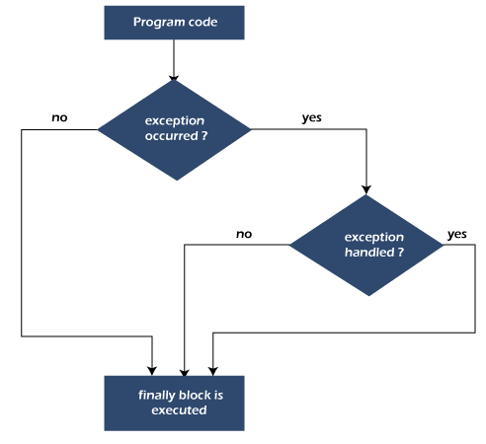
finally
finally block is an optional part of exception handling that is used to execute important code regardless of whether an exception occurs or not.
The finally block is always associated with a try block, and it executes after the try block and any catch blocks, even if an exception is thrown.
This is particularly useful for cleaning up resources such as closing files, releasing database connections, or freeing up other system resources.

Slide 33
Example 1: Exception is Handled
public class FinallyExampleHandled {
public static void main(String[] args) {
try {
int result = 10 / 0; // This will throw ArithmeticException
} catch (ArithmeticException e) {
System.out.println("Exception caught: " + e.getMessage());
} finally {
System.out.println("Finally block executed - Exception handled case.");
}
System.out.println("Program continues after try-catch-finally.");
}
}
Output:
Exception caught: / by zero
Finally block executed - Exception handled case.
Program continues after try-catch-finally.

Slide 34
Example 2: Exception is Unhandled
public class FinallyExampleUnhandled {
public static void main(String[] args) {
try {
int[] numbers = {1, 2, 3};
System.out.println(numbers[5]); // This will throw ArrayIndexOutOfBoundsException
} finally {
System.out.println("Finally block executed - Exception unhandled case.");
}
System.out.println("This line will not execute due to unhandled exception.");
}
}
Output:
Finally block executed - Exception unhandled case.
Exception in thread "main" java.lang.ArrayIndexOutOfBoundsException: Index 5 out of bounds for length 3
at FinallyExampleUnhandled.main(FinallyExampleUnhandled.java:5)

Slide 35
Example 3: Exception doesn’t occur
public class FinallyExampleNoException {
public static void main(String[] args) {
try {
int result = 10 / 2; // No exception here (10 / 2 is 5)
System.out.println("Result: " + result);
} finally {
System.out.println("Finally block executed - No exception occurred.");
}
System.out.println("Program continues after try-finally.");
}
}
Output:
Result: 5
Finally block executed - No exception occurred.
Program continues after try-finally.

Slide 36
Create your own exception (user-defined exception)
In Java, you can create your own custom exceptions to handle specific error scenarios that aren’t covered by Java’s built-in exceptions.
This is useful when you want to provide more meaningful error messages or enforce specific application rules.
Creating custom exceptions involves subclassing the Exception class (or one of its subclasses) and optionally adding custom fields and methods.
Steps to Create a Custom Exception
  Define a Class: Define a new class that extends Exception (checked exception) or RuntimeException (unchecked exception), depending on whether you want your exception to be checked or unchecked.
  Constructor(s): Add constructors to initialize the exception. Commonly, custom exceptions have constructors that accept a message and optionally a cause (another throwable).
  Additional Methods (Optional): Add any additional methods or fields that might help provide more details about the exception.

Slide 37
Example 1: Creating a Custom Checked Exception
Create a custom checked exception called InvalidAgeException, which is thrown when an invalid age is provided (for example, a negative age or an age greater than 150).
class InvalidAgeException extends Exception { // Define the custom exception
public InvalidAgeException(String message) { // Constructor that accepts a custom message
super(message);
}
}
public class CustomExceptionExample { // Using the custom exception
public static void main(String[] args) {
try {
validateAge(-5); // This will throw InvalidAgeException
} catch (InvalidAgeException e) {
System.out.println("Caught Exception: " + e.getMessage());
}
}
public static void validateAge(int age) throws InvalidAgeException { // Method to validate age
if (age < 0 || age > 150) {
throw new InvalidAgeException("Invalid age: " + age);
}
System.out.println("Age is valid: " + age);
}
}

Slide 38
Example 2: Creating a Custom Unchecked Exception
To create an unchecked exception, extend RuntimeException instead of Exception. This way, the compiler won’t require you to handle or declare the exception.
class NegativeBalanceException extends RuntimeException { // Define the custom unchecked exception
public NegativeBalanceException(String message) {
super(message);
}
}
public class CustomUncheckedExceptionExample { // Using the custom unchecked exception
public static void main(String[] args) {
withdraw(100, 150); // This will throw NegativeBalanceException
}
public static void withdraw(int balance, int amount) { // Method that checks for a valid balance
if (amount > balance) {
throw new NegativeBalanceException("Insufficient balance for withdrawal: balance is " + balance);
}
System.out.println("Withdrawal successful. Remaining balance: " + (balance - amount));
}
}

Slide 39
Redirecting Exceptions
In Java, redirecting exceptions refers to the process of catching an exception in one block and then throwing it again (or another exception) to be handled elsewhere.
This technique is useful when you want to add custom handling, such as logging or wrapping an exception into a more meaningful one, without fully resolving the issue within the current scope.
There are two main ways to redirect exceptions in Java:
  Re-throwing the Same Exception: Simply catch the exception and throw it again.
  Throwing a Different Exception: Catch one exception and throw a different exception, optionally including the original exception as the cause.

Slide 40
Example 1: Re-throwing the Same Exception
import java.io.FileReader;
import java.io.IOException;
public class ReThrowExample {
public static void main(String[] args) {
try {
readFile();
} catch (IOException e) {
System.out.println("Exception caught in main: " + e.getMessage());
}
}
public static void readFile() throws IOException {
try {
FileReader reader = new FileReader("non_existent_file.txt");
} catch (IOException e) {
System.out.println("Logging exception: " + e.getMessage());
throw e; // Re-throwing the same exception
}
}
}

Slide 41
Example 2: Redirecting the runtime Exception
public class RuntimeExceptionRedirect {
public static void main(String[] args) {
try {
calculate();
} catch (ArithmeticException e) {
System.out.println("Caught exception in main: " + e.getMessage());
}
}
public static void calculate() {
try {
int result = 10 / 0; // This will cause ArithmeticException
} catch (ArithmeticException e) {
System.out.println("ArithmeticException caught, re-throwing...");
throw e; // Re-throwing the same exception
}
}
}

Slide 42
Example 3: Wrapping and Throwing a Different Exception
You can catch one type of exception and wrap it in a custom exception to provide more context.
class CustomException extends Exception { public CustomException(String message, Throwable cause) { super(message, cause); } } public class WrapExceptionExample { public static void main(String[] args) { try { processFile(); } catch (CustomException e) { System.out.println("Caught CustomException: " + e.getMessage()); System.out.println("Original cause: " + e.getCause()); } } | public static void processFile() throws CustomException { try { FileReader reader = new FileReader("non_existent_file.txt"); } catch (IOException e) { throw new CustomException("File processing failed", e); // Wrap the IOException } } }

Slide 43
rethrow an exception
If a catch block cannot handle the particular exception it has caught, we can rethrow the exception.
The rethrow expression causes the originally thrown object to be rethrown.
You might do this when:
  You need to perform some cleanup or logging before passing the exception.
  You want the exception to propagate up the call stack for handling at a higher level.

Slide 44
Example
class RethrowExample {
public static void processData() throws Exception {
try {
// Simulate an error
throw new ArithmeticException("Division by zero");
} catch (ArithmeticException e) {
// Log or perform some cleanup
System.out.println("Logging exception: " + e.getMessage());
// Rethrow the same exception
throw e;
}
}
}
public class Main {
public static void main(String[] args) {
try {
RethrowExample.processData();
} catch (Exception e) {
System.out.println("Exception caught in main: " + e.getMessage());
}
}
}

Slide 45
Java Build-in exception classes
Java’s Unchecked RuntimeException Subclasses Defined in java.lang

Slide 46
Java Build-in exception classes
Java’s Checked Exceptions Defined in java.lang

